Slide 1
Ethics in AI
Mapping the landscape of Ethics in AI.
Adarsh singh

Slide 2
Ethics
AI
Ethics
&
AI
The Moral principles governing the behavior or actions of an individual or a group.
AI can be described as Data, Model and Prediction.
Ethics + AI
Ethics of AI lies in the ethical quality of its prediction, the ethical
quality of the end outcomes drawn out of that and the ethical quality of
the impact it has on humans.

Slide 3
Why does it matters ??
Why do we need Ethics in AI ?
AI has potential to “change the world”.
Optimizing logistics
Detecting deseasis,
fraud
Composing Arts
Translation
Making Decision
Conducting research

Slide 4
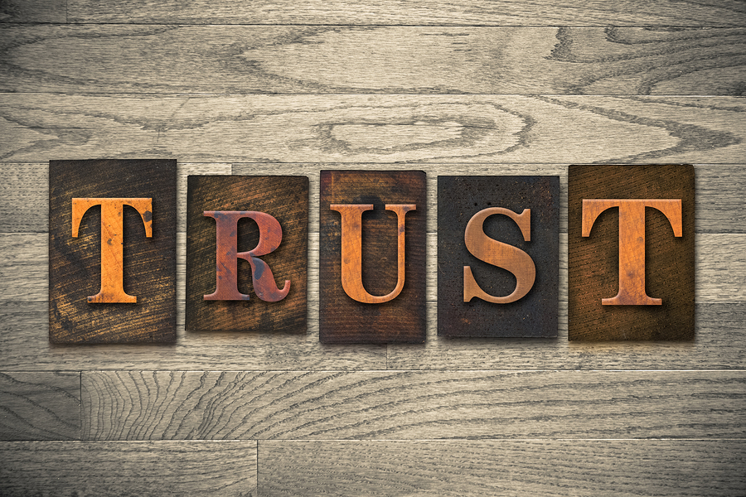
So how can we question AI ?
we can ask a simple question that
how right, how fair and how just,
is an algorithmic systems’ output, outcome and impact?
what more we need from AI other than just predictions?

Slide 5
So how Ethics helps us to prevent such harm and
can help in building trust ?
The ethical obligations placed upon a technology and its
creators demand that they work towards preventing all such
harms.
Ethics helps us to identify and to stand against any
injustice or partiality being
done to any individual in the society due to a malicious model.
Hence their is the need of Ethics in AI.

Slide 6
Mapping the landscape of Ethics in AI
AI in Ethics points to either the ethical quality of predictions or of end outcomes or their direct and indirect impact to humans
What AI is ?
What AI does ?
What AI impact ?
Bais and
Fairness
Accountability
and
Transperency
Safety
Cyber-security
and
Privacy
Unemployment
Inquality

Slide 7
What AI is ?
AI is data, model and prediction but Ethical exploration of this realm includes issues
such as :-
Biasness and Lack of Fairness
Absence of Accountability and Transparency
AI are made by humans or are trained on data generated by humans, therefore its can amplify
human biasness at a large scale and this has consequences.
Biased algorithmic systems can lead to unfair outcomes, discrimination, and injustice.
At large scale.

Slide 8
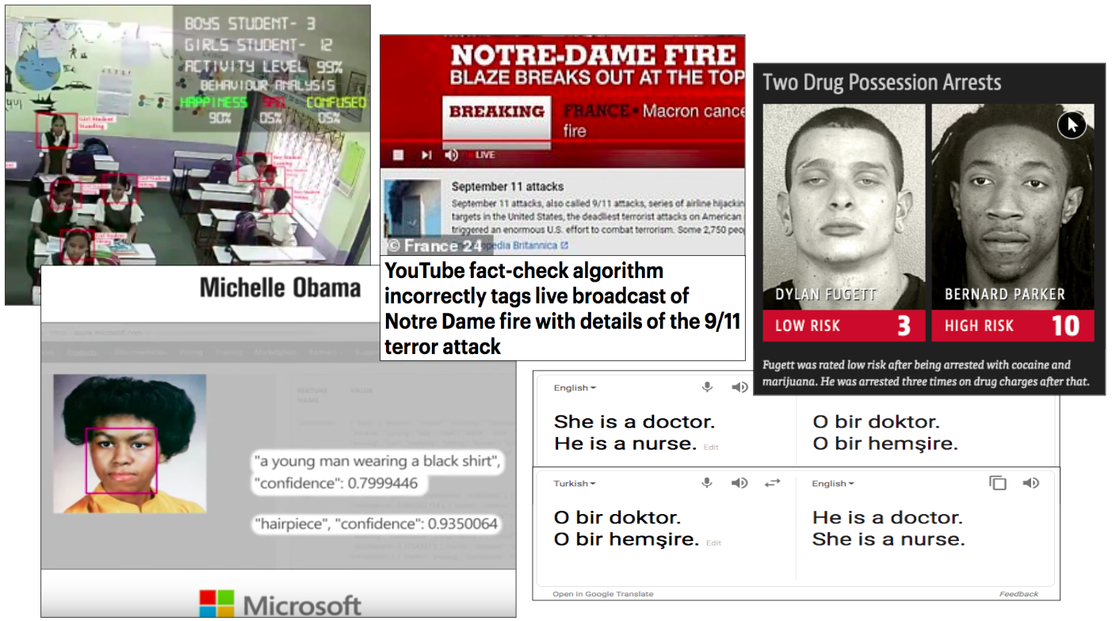
Example

Slide 9
What AI does ?
AI uses lots of computation and some rules to analyse, identify, classify, predict, recommend and when allowed, make decisions for us.
Making decisions that can alter the course of a human life permanently is a huge
responsibility.
In the absence of an inbuilt ethical bias, an AI system can be used to help us or harm us.
So what can we do to prevent any harm from any AI outcome
Safety
Cyber-security and Privacy

Slide 10
What AI impacts ?
AI increasingly impacts everything, these effects are complex, multi-dimensional and significant at scale
and understanding them requires time and expertise.
This is especially so when products outgrow their original intent and audience and reach a
scale where it meets a large audience and than fails miserably.
We are seeing this happen with Social Media impacting democracies around the world
ecomomy.
Issues such as :-
Unemployment
Inequality
Democracy and civil right or Human-human interaction

Slide 11
Conclusion
The ethics of building AI for humans requires understanding humans, and all of their discontinuities. This is not a metrics-driven time-bound high-returns high-growth
venture, but a deeply valuable one nonetheless.

Slide 12
Thank you

